Slide 1

IBM Data Science Capstone Project

Slide 2

INTRODUCTION

Slide 3

In many cases when a person must move to another city or even country, she knows nothing about the new location, and it becomes extremely difficult to choose optimal place to search for a new home/flat.
At the same time, this person has some preferences about what she does and doesn’t want to have near her future home, alongside with some restrictions and limitations, for example – budget limitations.
The system that was developed during this capstone projects is designed to help solve the stated problem based on such parameters.

Slide 4

DATA ACUISITION CLEANING TRANSFORMATION

Slide 5

DATA SOURCES
BetaNYC portal (data.beta.nyc):
Information about New York Census Tracts;
Geoshapes of each Tract;
Foursquare API:
Information about venues in each Census Tract
Venue preferences of a made-up family that must relocate from Torrington to New York

Slide 6

DATA CLEANING and TRANSFORMATION
Removed location records that had zero costs;
Removed records that didn’t satisfy budget limitations;
Combined data from different sources into a single dataframe.

Slide 7
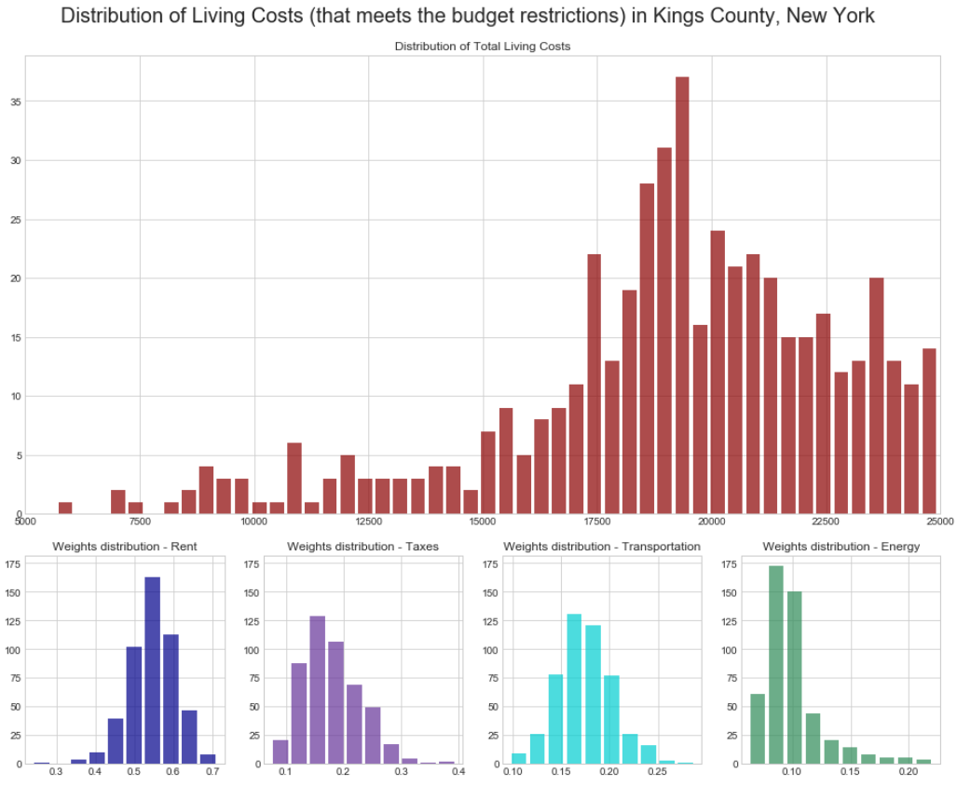
LOCATIONS DISTRIBUTION
By medium Annual Total Cost of Living and by Costs structure
Most of the Tracts that meet budget limitations have annual cost of living from $15,00 to $25,000
In majority of Tracts more than 50% of total expenses fall on Rent payments

Slide 8
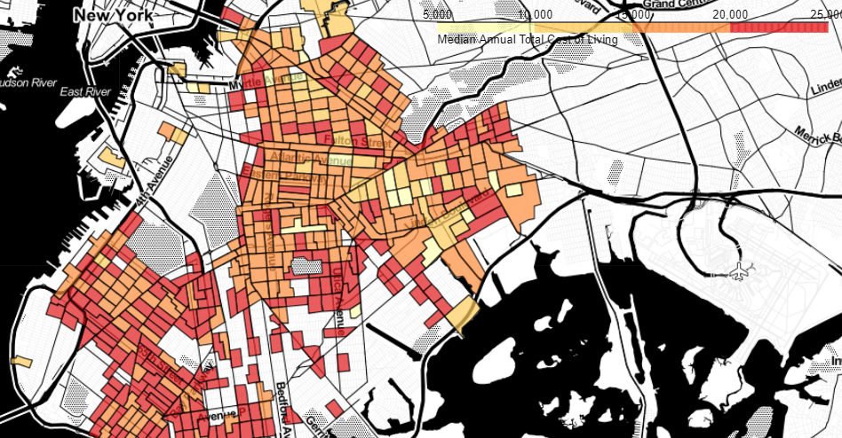
KINGS COUNTY MAP
COLOR: MEDIUM ANNUAL TOTAL COST OF LIVING

Slide 9

RECOMMENDATION SYSTEM

Slide 10
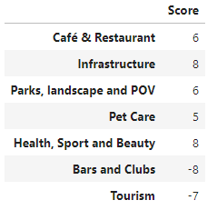
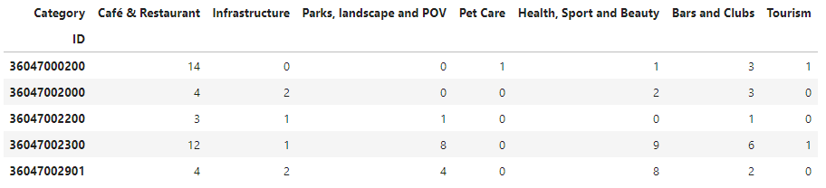
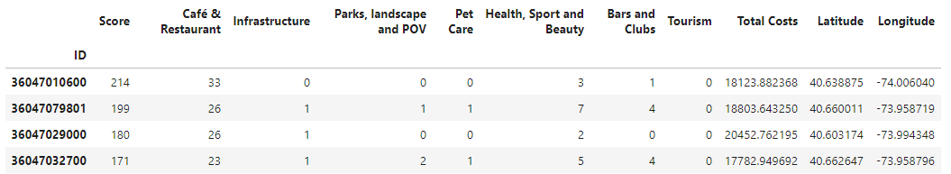
SYSTEM MECHANICS
VECTOR MULTIPLICATION BETWEEN USER PREFERENCES AND LOCATION CHARACTERISTICS
*

Slide 11

RESULTS

Slide 12

SCORING OPTIONS
1
ABSOLUTE SCORE
2
OPTIMAL SCORE
If we want to suggest them locations with the highest Score, the only thing that we need to do is to take top N rows of the result dataframe
Choose locations that provide best score for a given sum of money

Slide 13
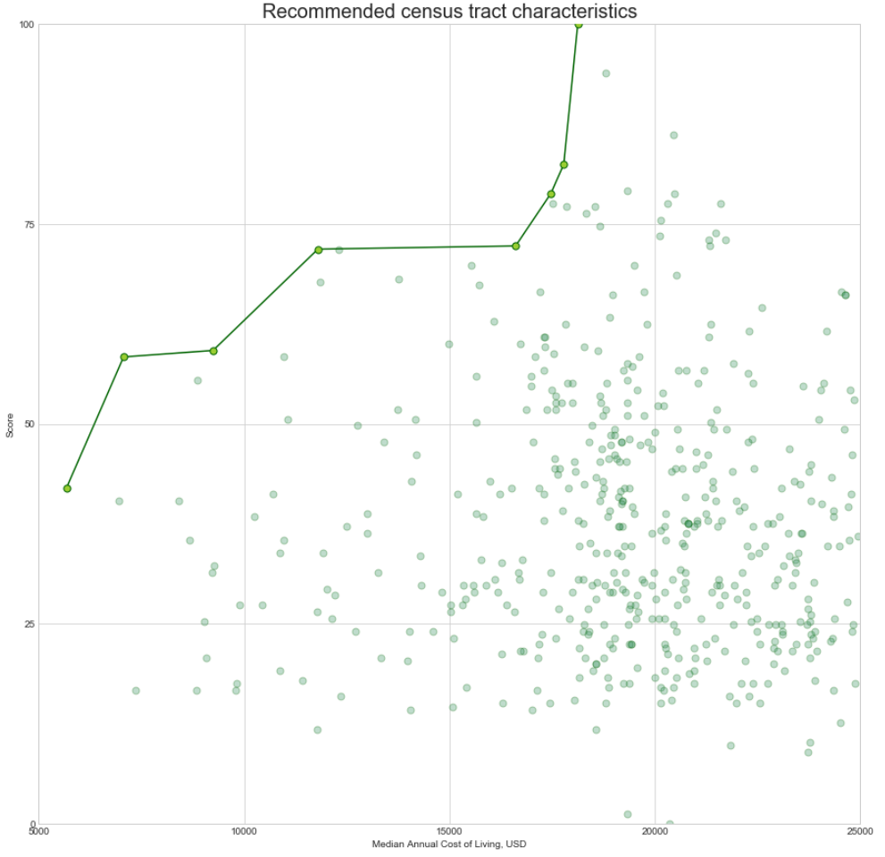
OPTIMAL LOCATIONS
SUBTITLE HERE
Points located bellow the line are possibly less attractive
Why? Because for each of these options exists another one that provides higher score or/and lower annual cost.
Why 'possibly'? Because this is only score representation of computed 'attractiveness' of each recommended location, in the real life it could be the situation that a location with a lower score would be much more interesting to the final Customer.

Slide 14
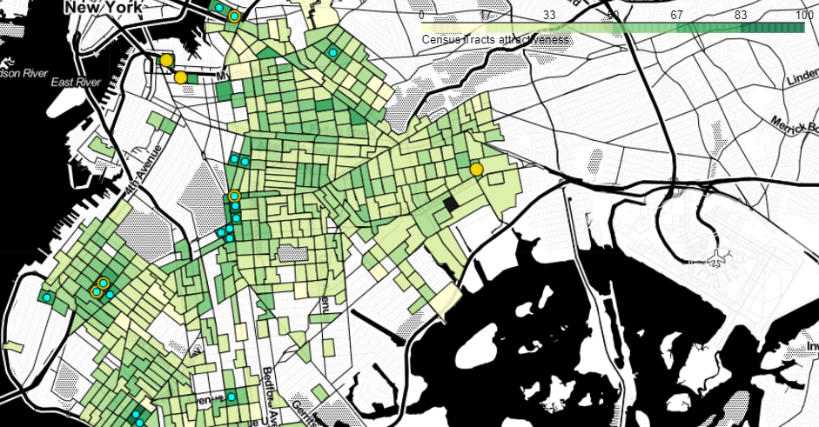
KINGS COUNTY MAP
COLOR: TRACT SCORE, YELLOW DOTS: OPTIMAL LOCATIONS, BLUE DOTS: TOP 20 BY SCORE

Slide 15

CONCLUSION AND FUTURE DIRECTIONS

Slide 16

Although the implemented model is very simple, it already helped us to narrow down list of possible locations for a new home from almost 500 to 20 or even 8 options;
Recommendation system could be further improved, for example, by extracting the category scores from the list of neighborhoods/tracts with their ratings provided by the customer/user;
We made an assumption that the number of desirable/unwanted venues equally important as their scores. The system could be improved by introducing some kind of weight coefficients for each additional venue of the same type;

Slide 17



THANK YOU
SERGEI MERSON
sergei..merson@gmail.com

